Slide 1
Data Analytics with Python
Instructor Ilias Suvanov

Slide 2

Ilias Suvanov
m.a in economics AUCA
m.a in mathematics in HSE
Micromasters in MITx DEDP

Slide 3
DATA
What is Python
Why Python
Plain Python code vs Jupyter Notebook
Interesting Jupyter Notebooks
Google Collab
Arithmetic operations, variables and strings in Python

Slide 4


DATA IS PLENTIFUL

Slide 5
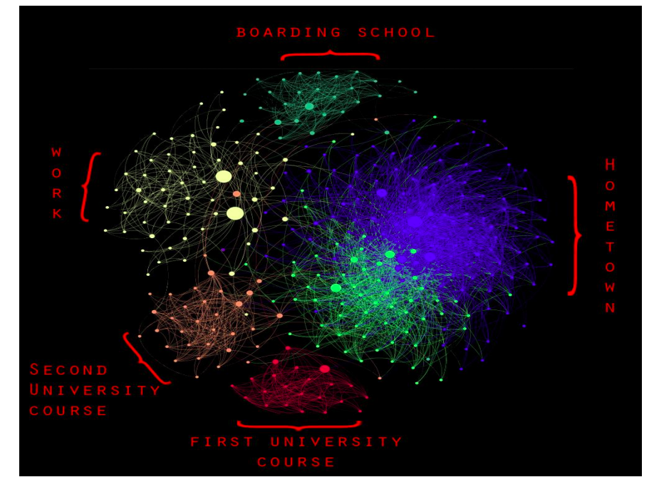
DATA IS BEAUTIFUL

Slide 6
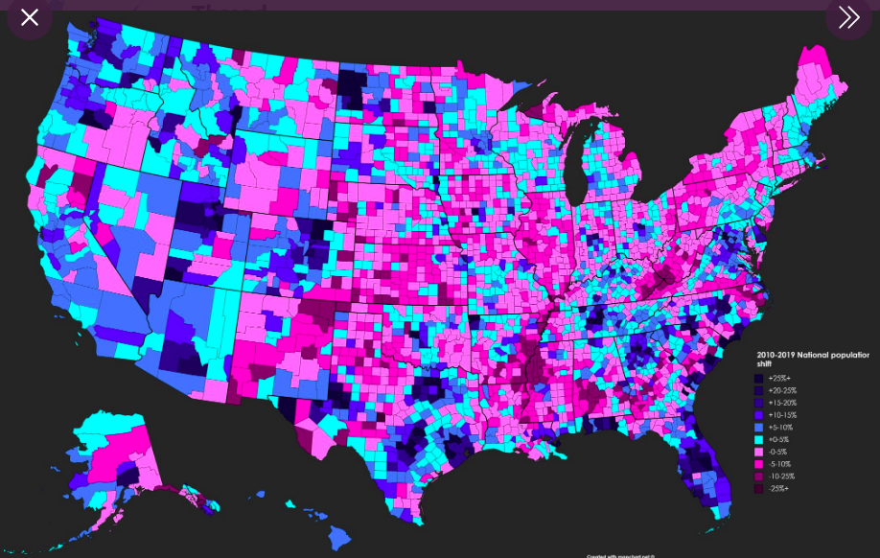
DATA IS BEAUTIFUL

Slide 7
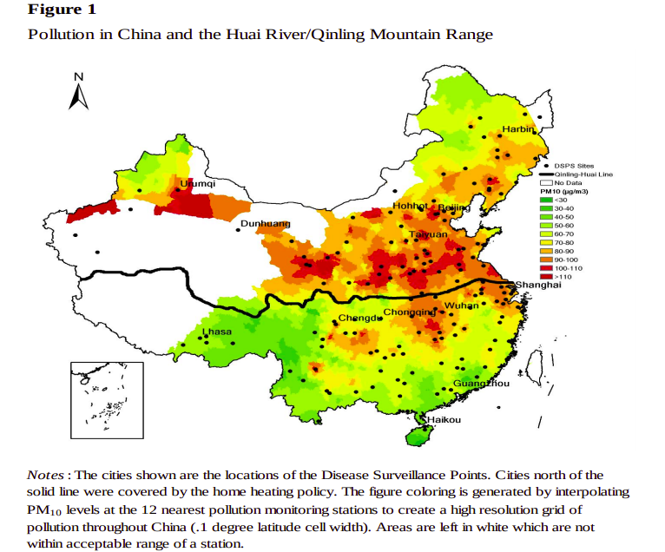
DATA IS INSIGHTFUL

Slide 8
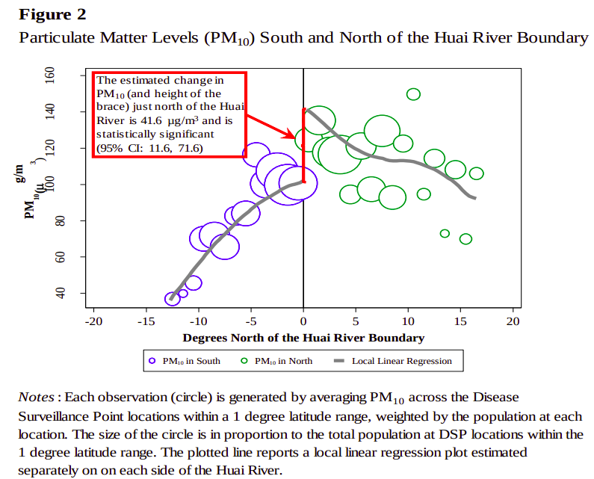

Slide 9
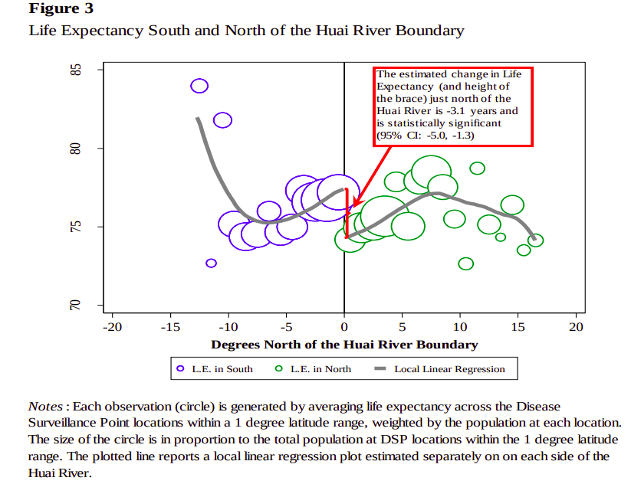

Slide 10
Remarks:
https://www.tylervigen.com/spurious-correlations
Useful Link:
https://www.reddit.com/r/dataisbeautiful/

Slide 11
What is Python
Python is a high-level programming language designed to be easy to read and simple to implement. It is open source, which means it is free to use, even for commercial applications.

Slide 12
Why Python?
Python | Java | C++
Easy to read and write code | Not so easy to read and write | Very hard to read and write
Dynamically typed | Not Dynamically typed | Not Dynamically typed
Short English like syntax | Long syntax | Hard to understand syntax
Easy to learn | Not so easy to learn | Hard to learn
High-Level | Some Low-level facilities | Low-level
Data mining, Machine learning, Statistycal Analysis | -- | --

Slide 13
name = input() print("Good evening, " + name) | #include #include using namespace std; int main() { string name; cin >> name; cout << "Good evening, " << name << endl; return 0; }

